Slide 1
Mr. Lors
Class: 701
Subject: Social Studies

Slide 2
The THIRTEEN COLONIES: State of Delaware Presented by Mr. Lors

Slide 3
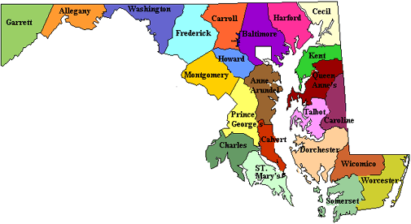
Colony: Delaware
First State
Founded:1638
By: Peter Minuit
This state was founded in order to get its independence from British colonial ruling of Kings Charles II.
HISTORIANS:
Allen Guelzo
Henry R. Luce

Slide 4
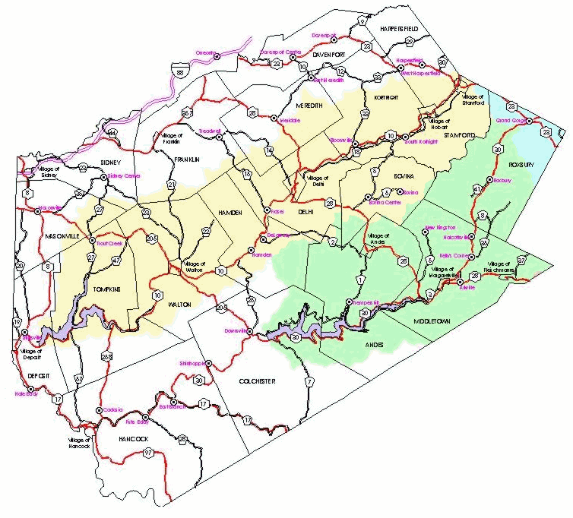
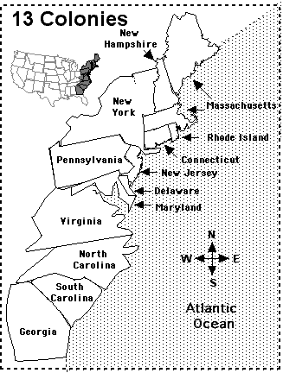
Map of Delaware
Delaware is
Located to the North east of the United States

Slide 5


Where did the Settlers
come from?
The Settlers of Delaware came from Holland the Dutch People.
Why did they settle there?
They settled there in order to get rich from wealth of the new world.

Slide 6
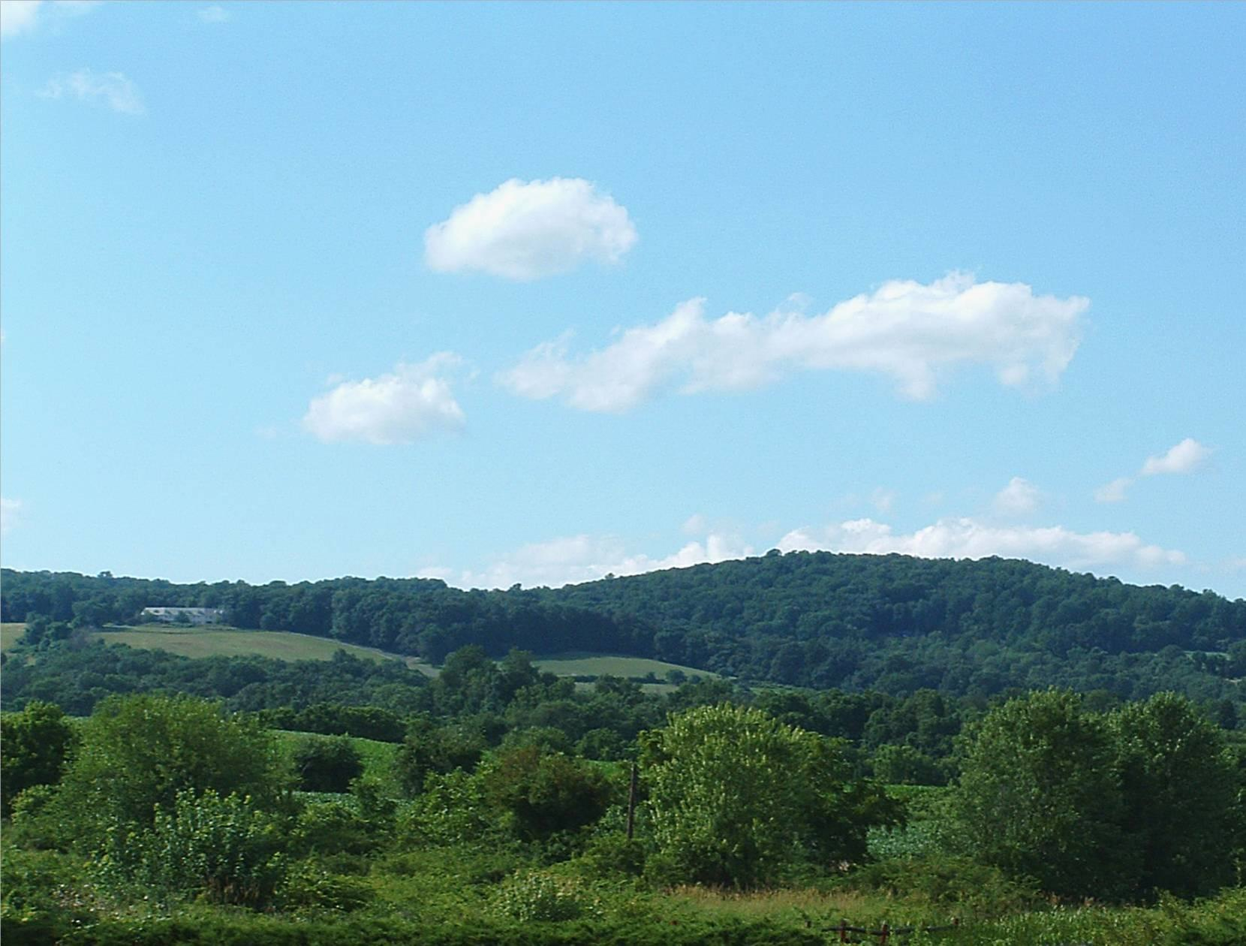
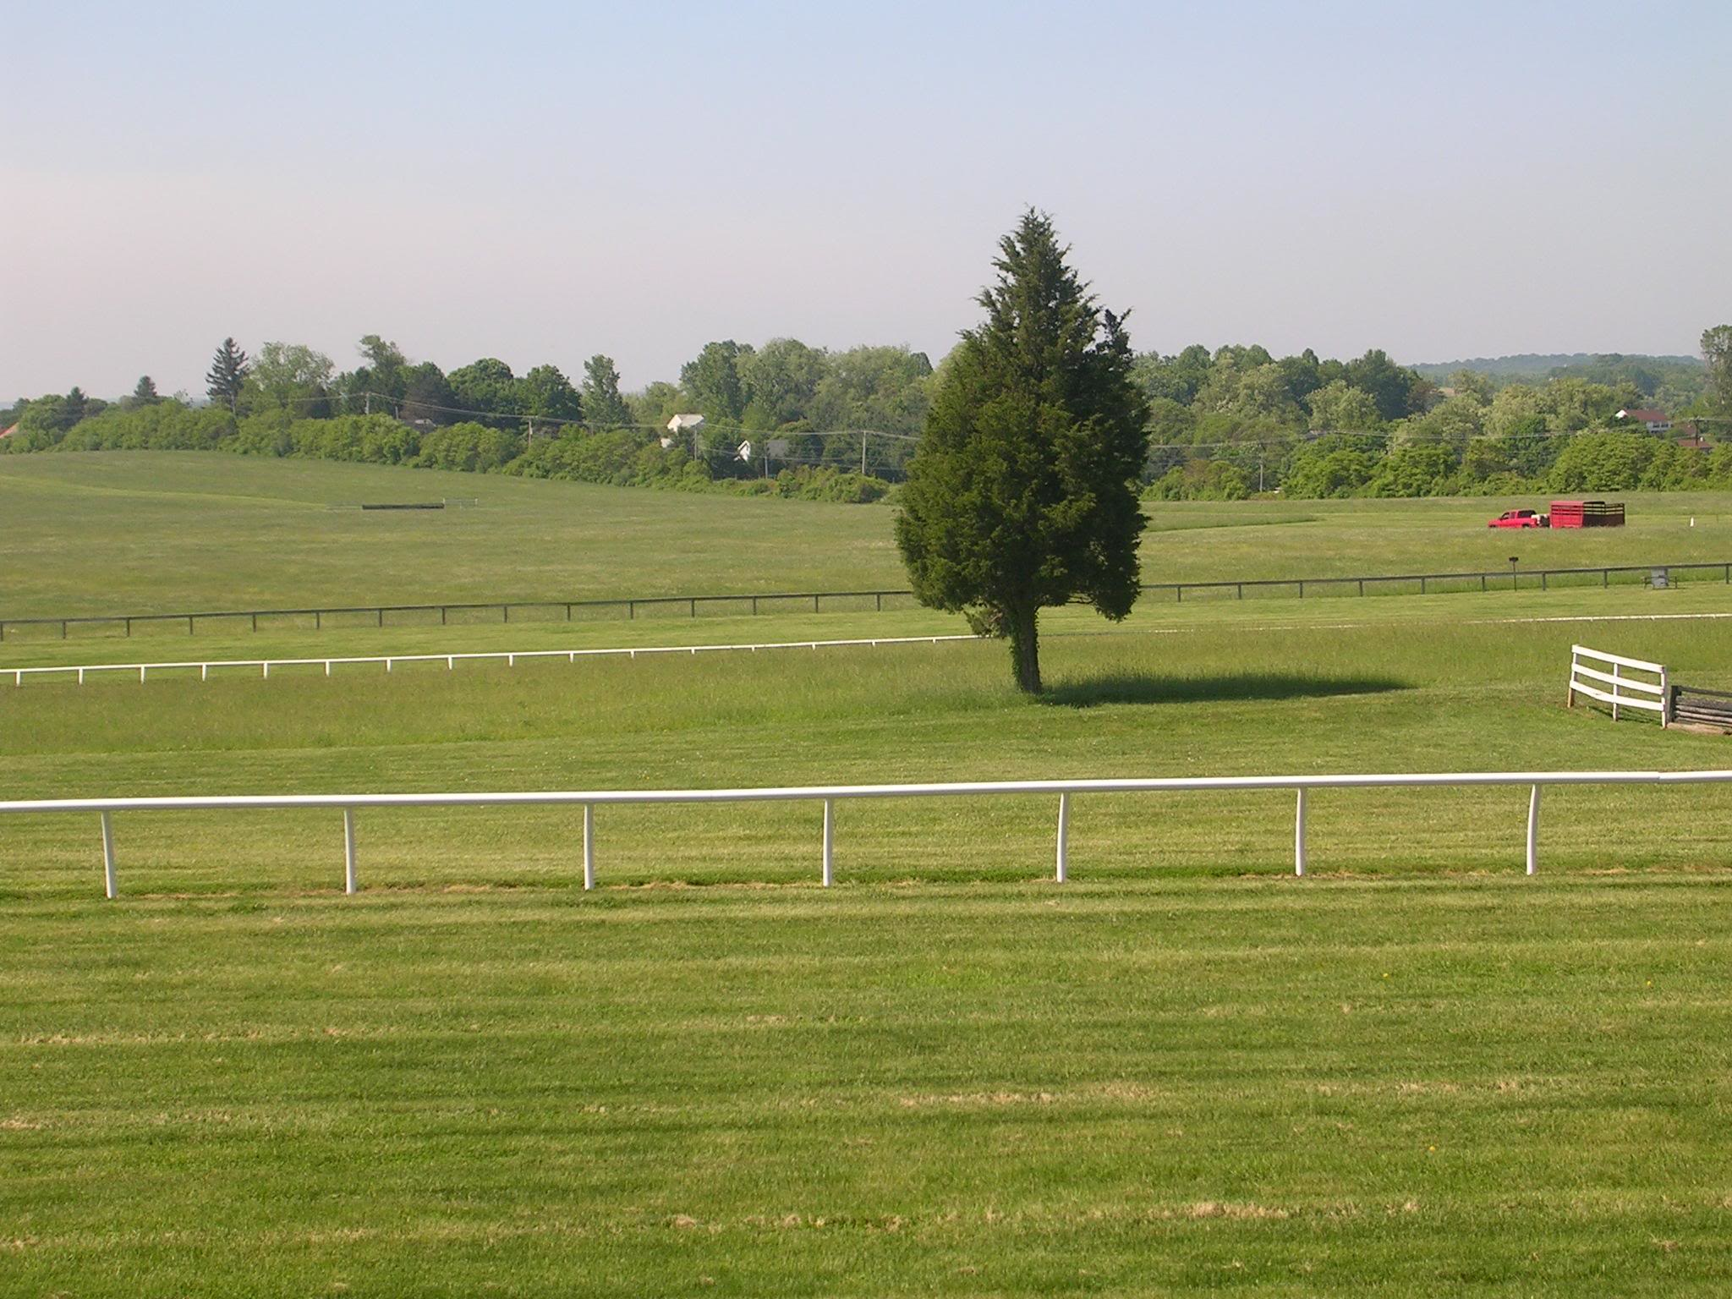
Geographic Characteristics
Made up of river valleys
Rolling Hills and Fertile Soil
They had large farms and a lot of surplus food.
Diverse population helps with the manufacturing life.

Slide 7
What Role did Religion Play?
People came to the colony due to persecution from Europe.
They were fleeing persecution and wanted a better place to worship and practice freely their religion.
They made sure that their experience from Europe never repeated again in the colony
.

Slide 8
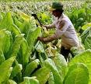
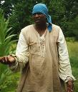
Economic Development and Slavery
The economy of Delaware was strongly based on Tobacco
The Slaves worked the Tobacco Plantation that helped build the Economy.
At the end of the colonial period, the economy moved to mixed farming.
Then they were less need for slaves

Slide 9
Economic, social and Political Developments
Social: Freedom of the press took place in the middle colony.
Political: Williams Penn intended the political atmosphere to be peaceful between the Dutch and the Indian.
Economic: The state had its economic boom from farming. Grain and livestock were grew by farmers.
For trading they used raw materials which were parts of their manufacturing items.

Slide 10
Delaware Colonial Time Line: 1631-1750

Slide 11
Work Cited
1. Google.com
Yahoo.com

